Slide 1


Strategic insights for Goodcabs to achieve growth and improve passenger satisfaction

Slide 2
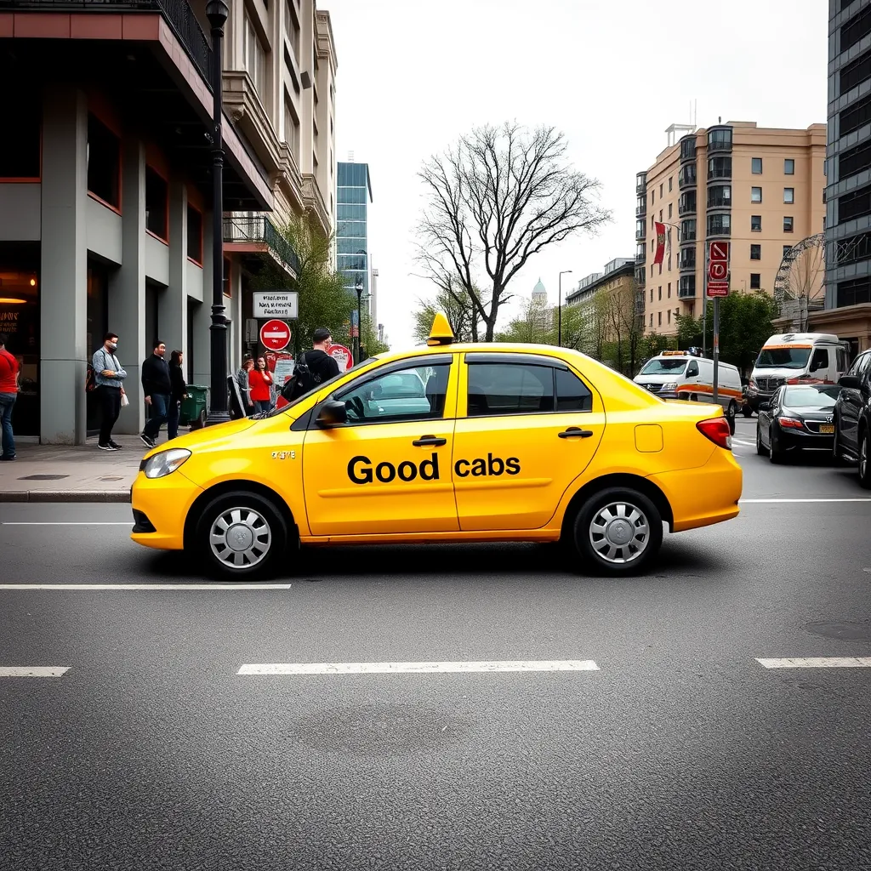
Agenda
Problem Statement
Goal
Dashboard Showcase
Insights
Recommendations

Slide 3
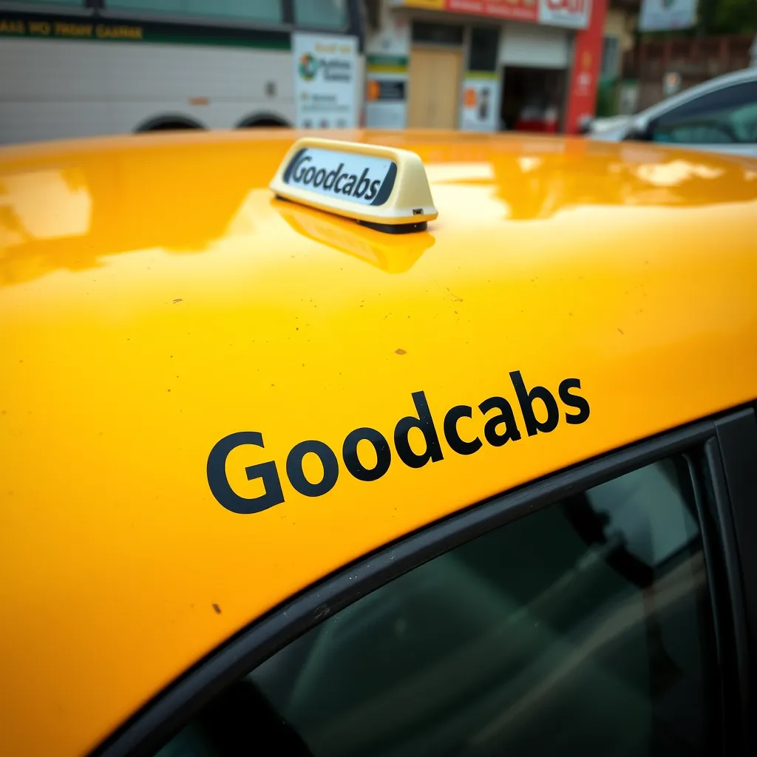
Problem statement
Goodcabs with operations in 10 tier-2 cites across India.
Goodcabs has set ambitious performance targets for 2024 to drive growth and Improve passenger satisfaction

Slide 4
Goal
My goal is to analyze the provided data, create impactful Metrics and Visuals and develop a user-friendly dashboard for Goodcabs leadership
The objective is to deliver data-driven recommendations to Mr. Bruce Haryali chief of operations of Goodcabs

Slide 5

Insights
Top performing cities
Even the Avg. fare per trip and Avg fare per km is high , Jaipur is being the top contributor in terms of trips as well as revenue.
In April and may alone Jaipur contributed almost 11 millions in revenue .
Lucknow is being the second highest in the total trips but it is 4th in terms of revenue generation, mainly because of both the Avg. fare per trip and Avg. fare per km is moderately low.

Slide 6
Insights
Diving into categories
Business vs Tourism
we can observe the cities with tourism background is mainly active in the weekends and the cities with the Business background is active in weekdays.
Jaipur > Tourism > Trips surge in the Weekends.
Kochi > Tourism > Trips surge in the Weekends.
Lucknow > Business > Trips mainly active in the Weekdays.
Surat > Business > Trips mainly active in the Weekdays.
Based on this analysis we can give offers in Rate while in the weekdays or weekends to attract more passengers.

Slide 7
Recommendations
It is good that new customers are increasing in the business, but at the same time, we need to retain them as repeat customers. Plan strategies including giving discounts on the next few rides to increase the loyal customer base across the cities mainly low performing cities.
Build partnership with the Local Businesses like Hotels ,Restaurants, shopping complex’s, Theme parks,. etc to Increase the revenue by showing them as Ads in the app.
We must prioritize improving our performance and achieving higher ratings in underperforming states such as Surat and Vadodara
By embracing electric vehicles, we can demonstrate our commitment to a greener future and elevate our brand reputation.

Slide 8
